Slide 1
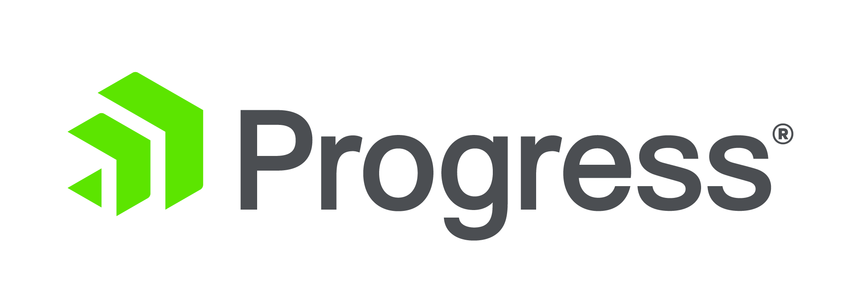
One Project. One Language.
Three Apps.
TJ VanToll (@tjvantoll)
Notes:
Today I’m going to talk about something that I think is pretty cool.

Slide 2
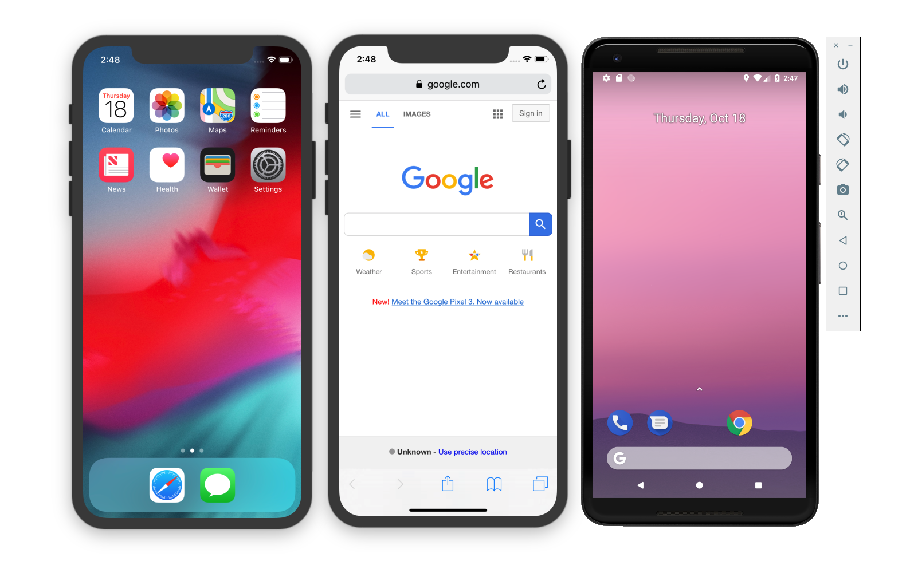
iOS
Web
Android

Slide 3


Agenda
Background (~15 minutes)
Demos (~25 minutes)

Slide 4
Web vs. Native

Slide 5
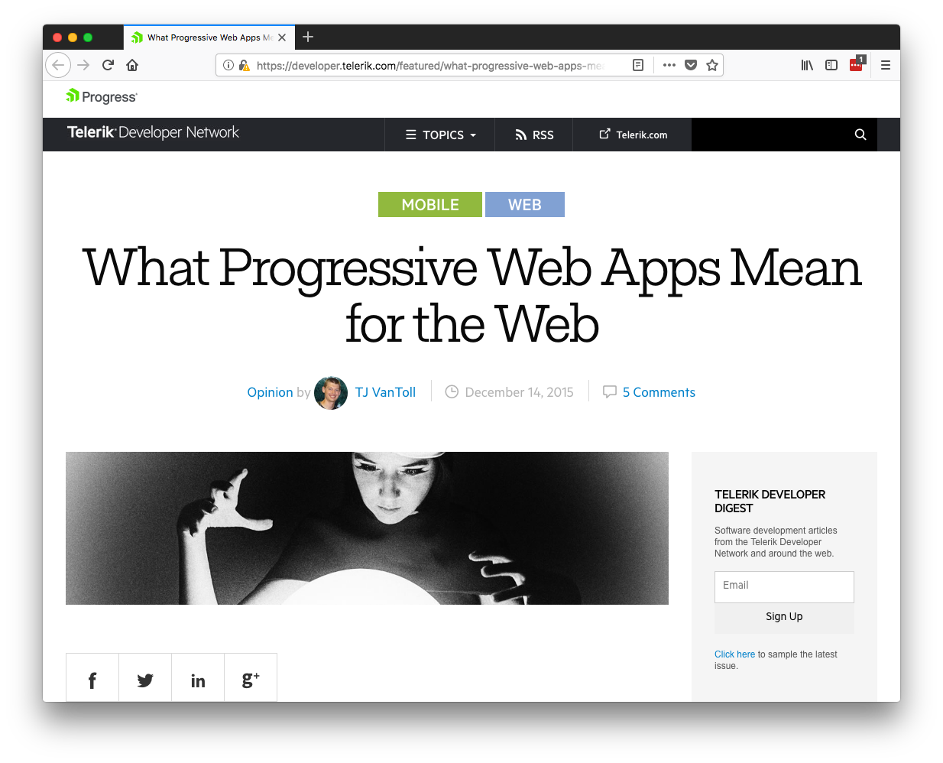

Slide 6
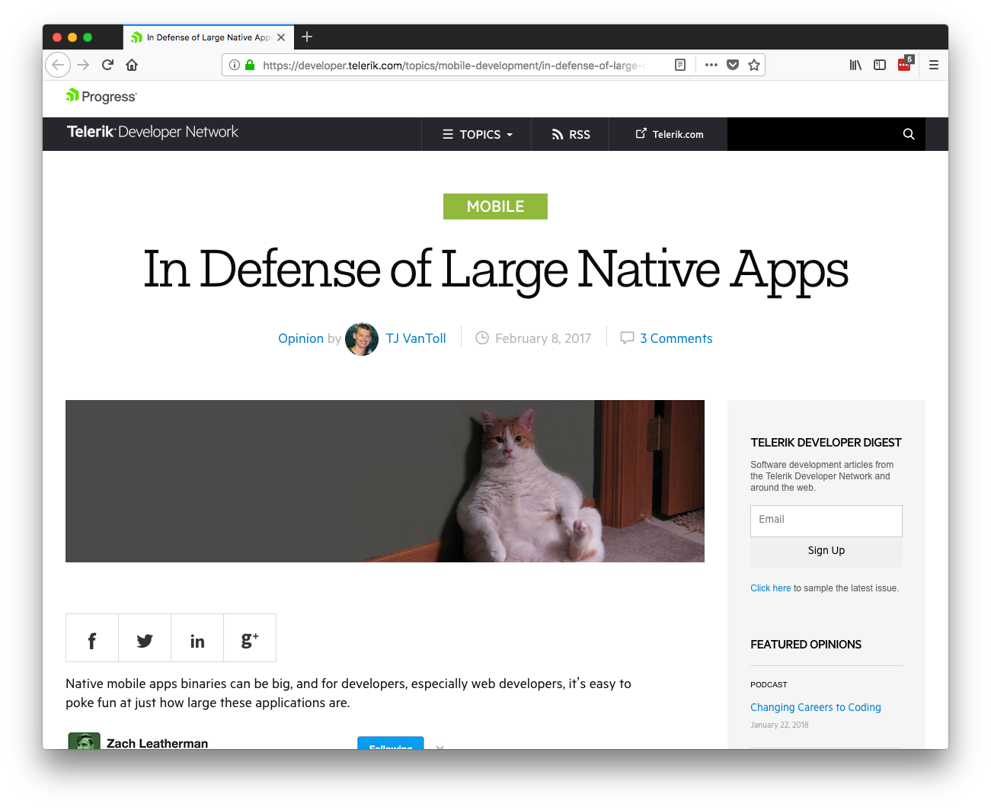

Slide 7


Slide 8
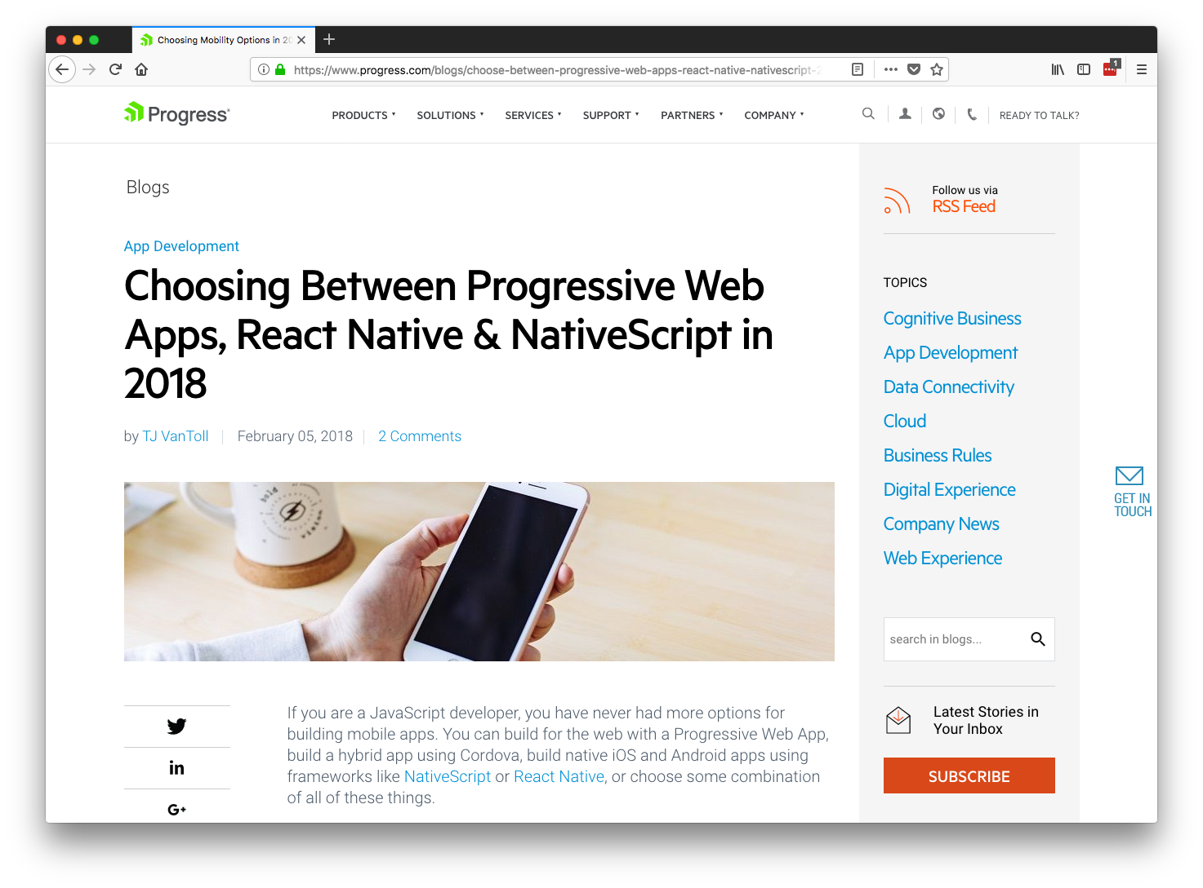

Slide 9
Web vs. Native

Slide 10
Native Benefit: User behavior
“Apps account for over 90% of internet time on smartphones and 77% of internet time on tablets.”
Source: https://www.emarketer.com/content/mobile-time-spent-2018

Slide 11
Web Benefit: Reach and ease of access
The average mobile web property captures 2.2x more monthly unique visitors than the average mobile app.
Source: https://www.slideshare.net/comScoremarcom/2017-us-mobile-app-report

Slide 12
Web vs. Native

Slide 13
Web vs. Native

Slide 14




Both
Web vs. Native

Slide 15
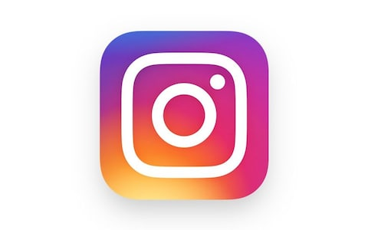




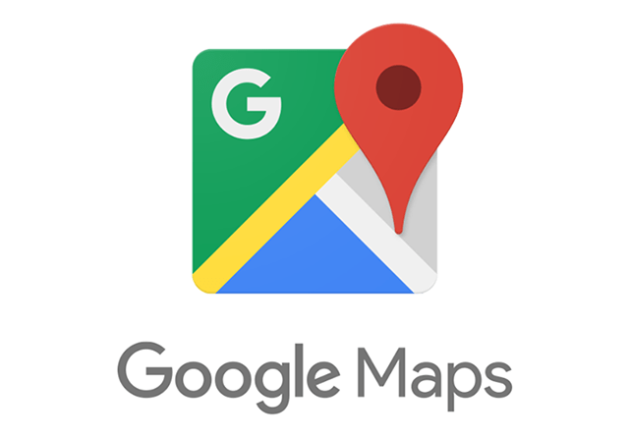

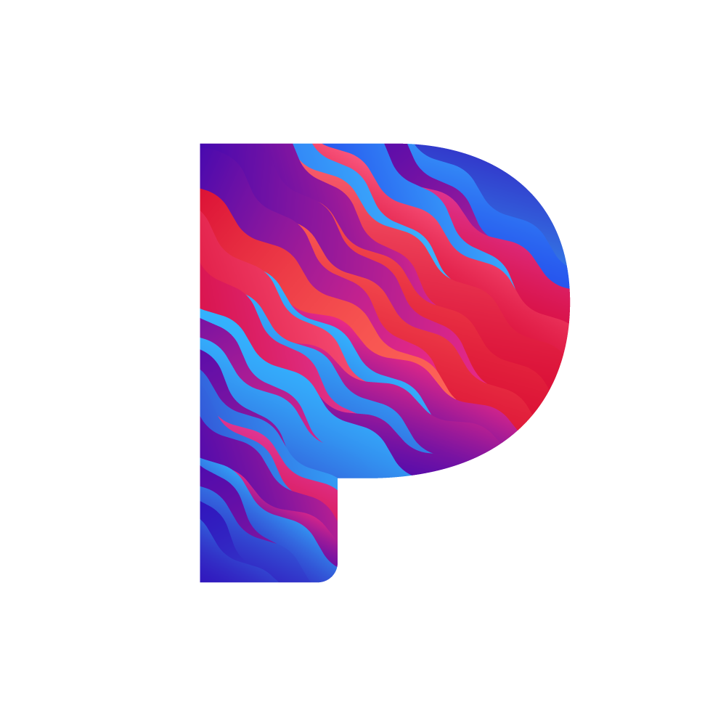


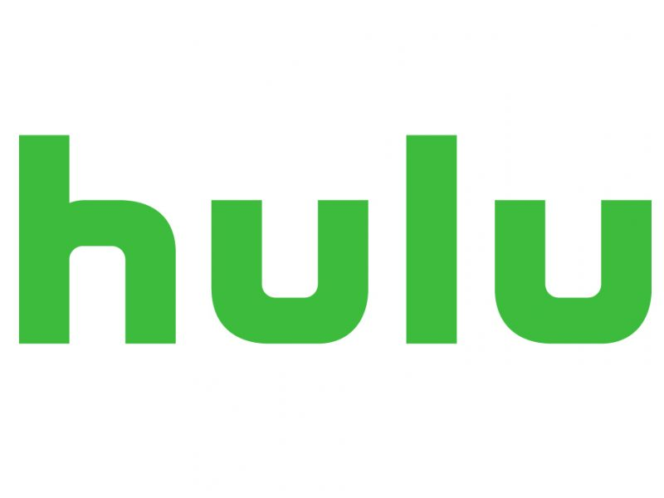

Slide 16
Web vs. Native

Slide 17

Approaches
1) React Native Web
2) NativeScript Schematics

Slide 18
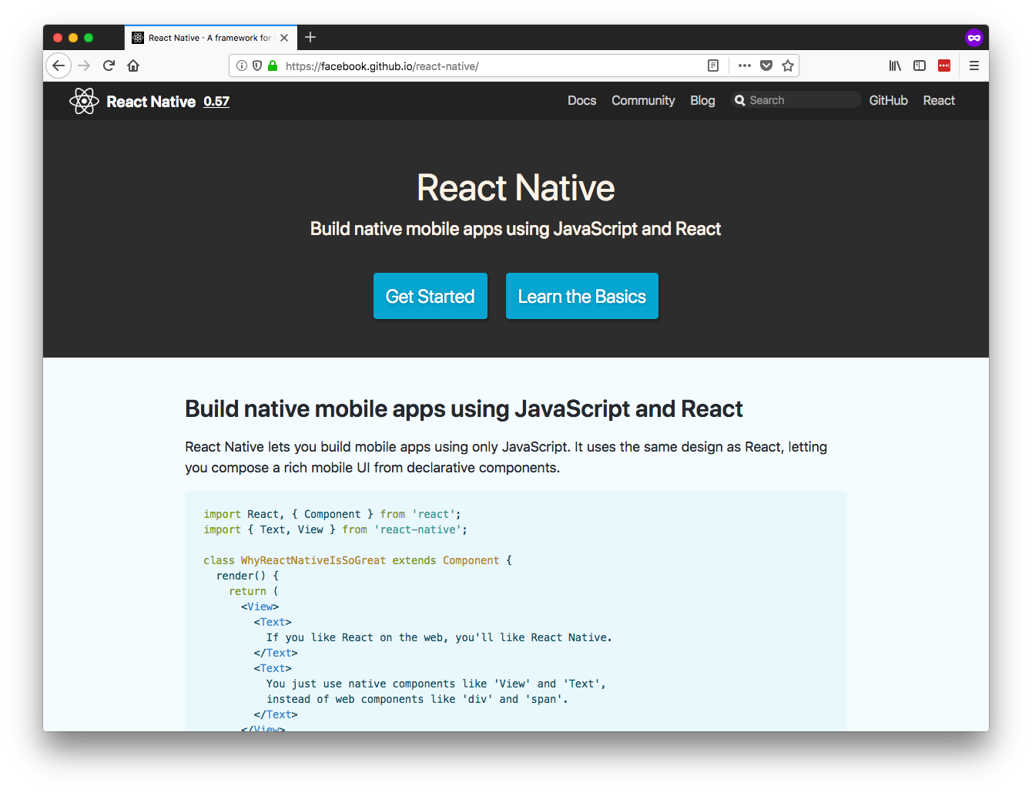
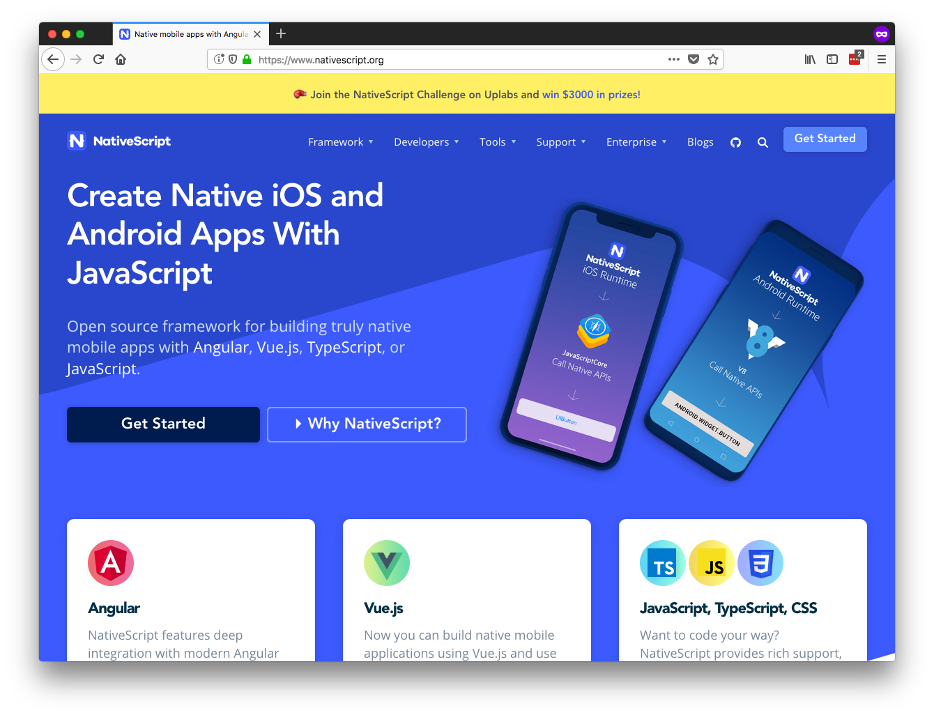

Slide 19
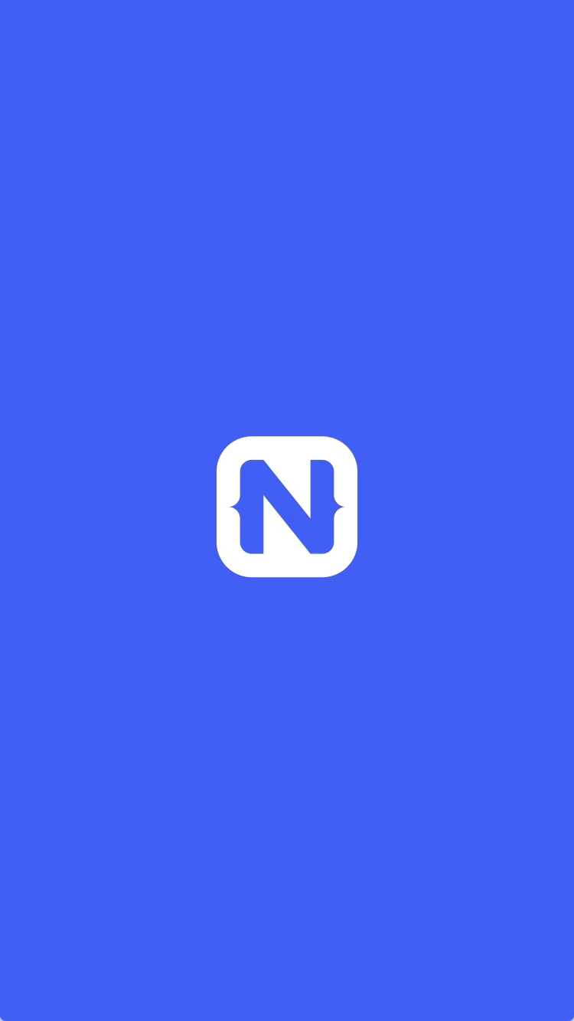

Slide 20
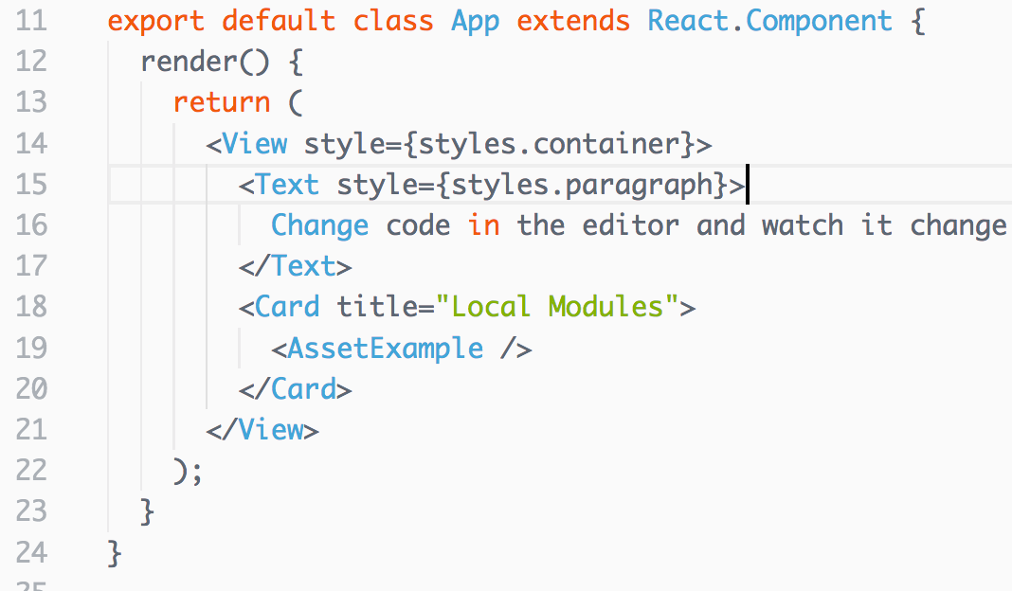
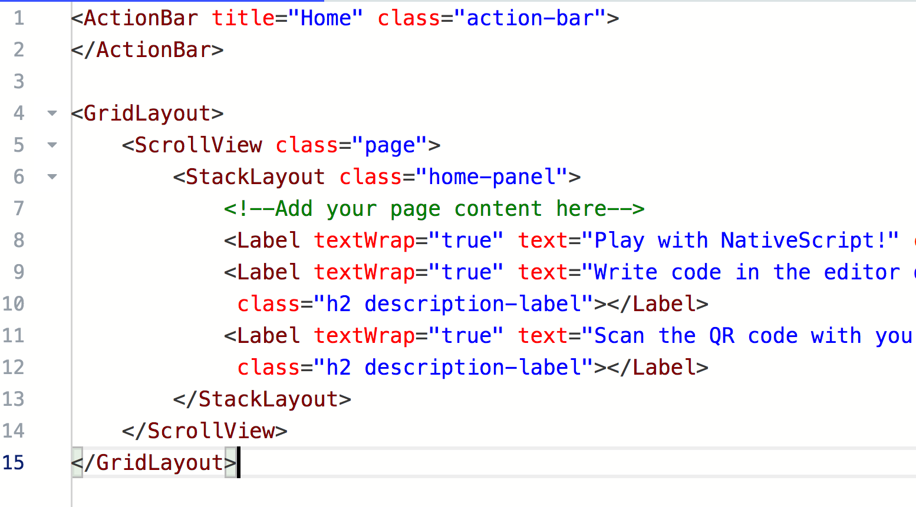

Slide 21
Approaches
1) React Native Web
2) NativeScript Schematics

Slide 22
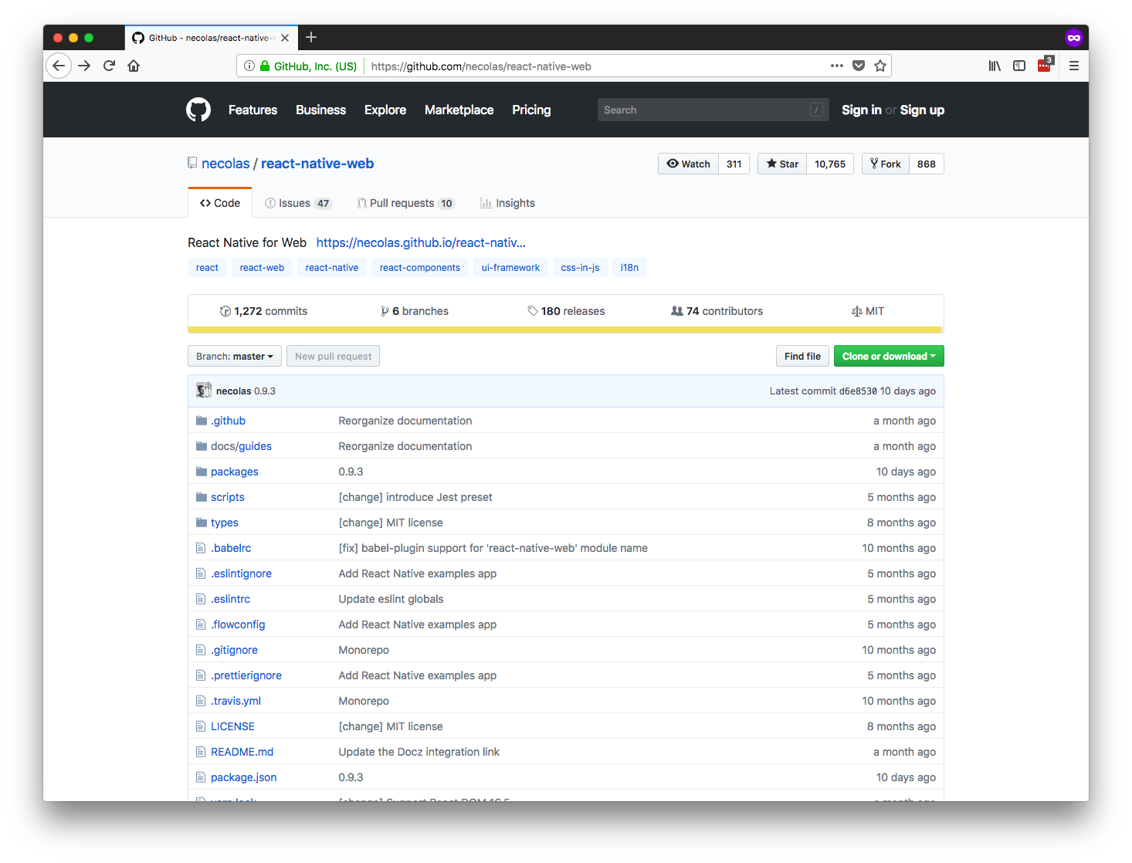
Notes:
Nicolas Gallagher

Slide 23
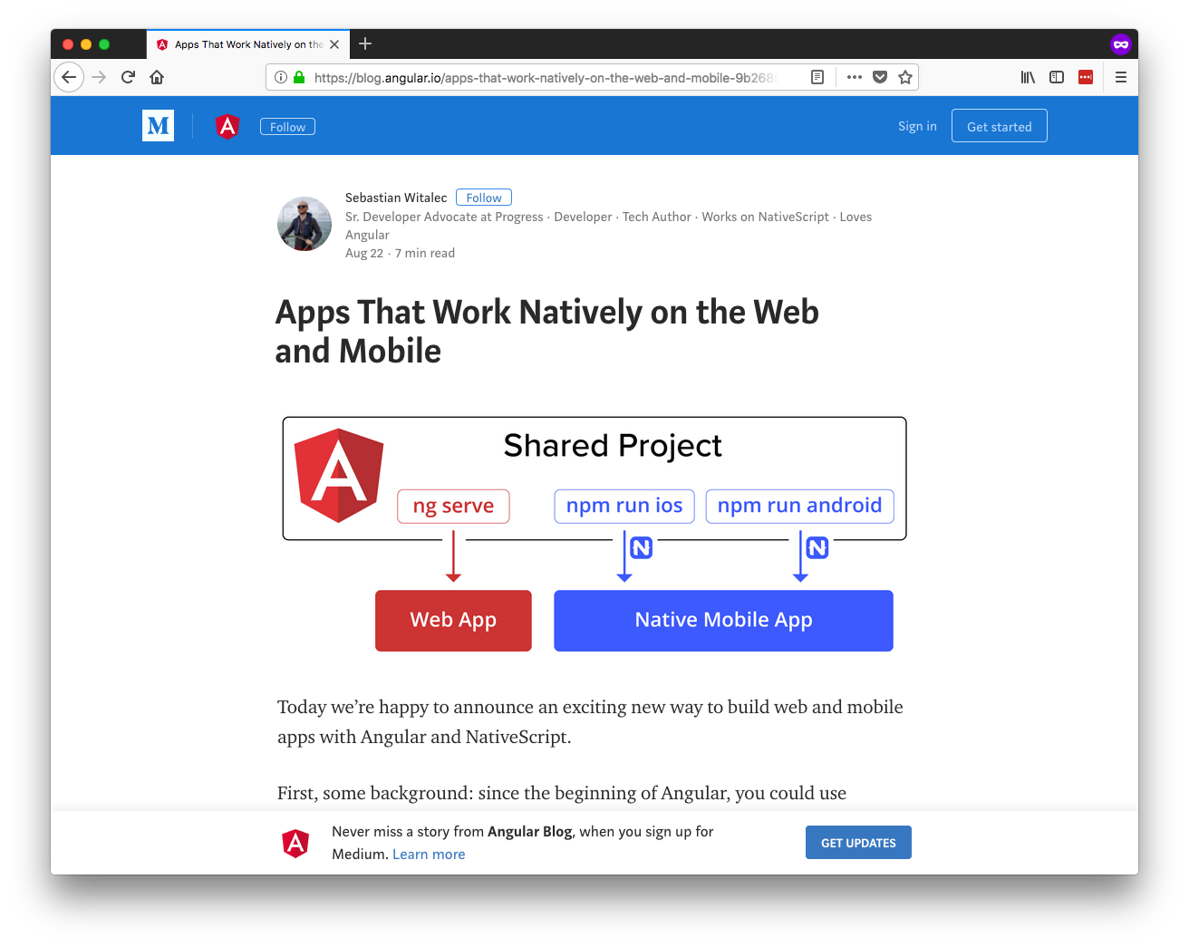

Slide 24
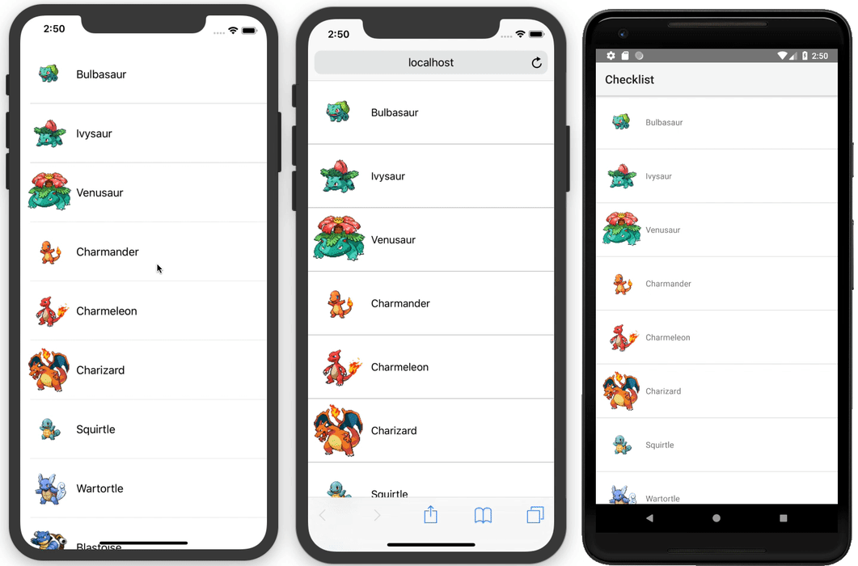

Slide 25
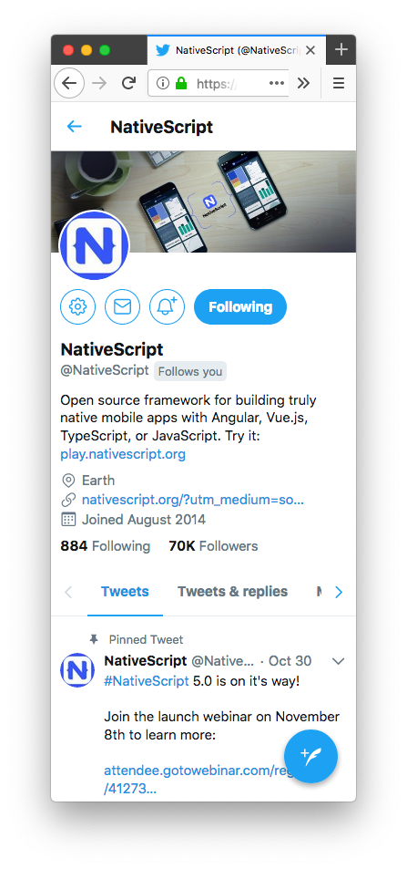
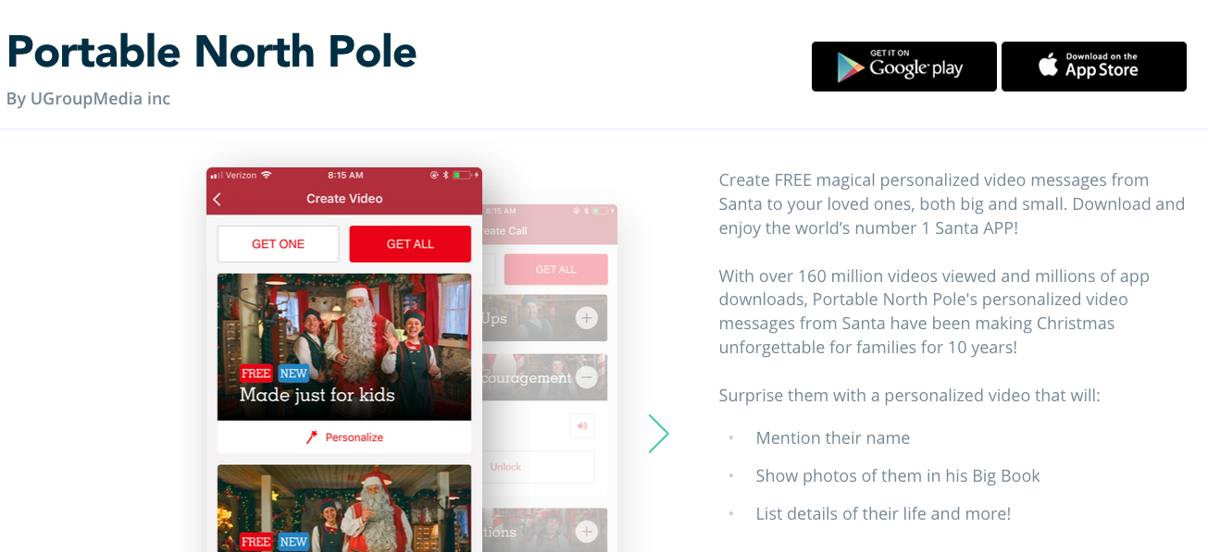

Slide 26
Demo 🎸

Slide 27
Notes:
Nicolas Gallagher

Slide 28
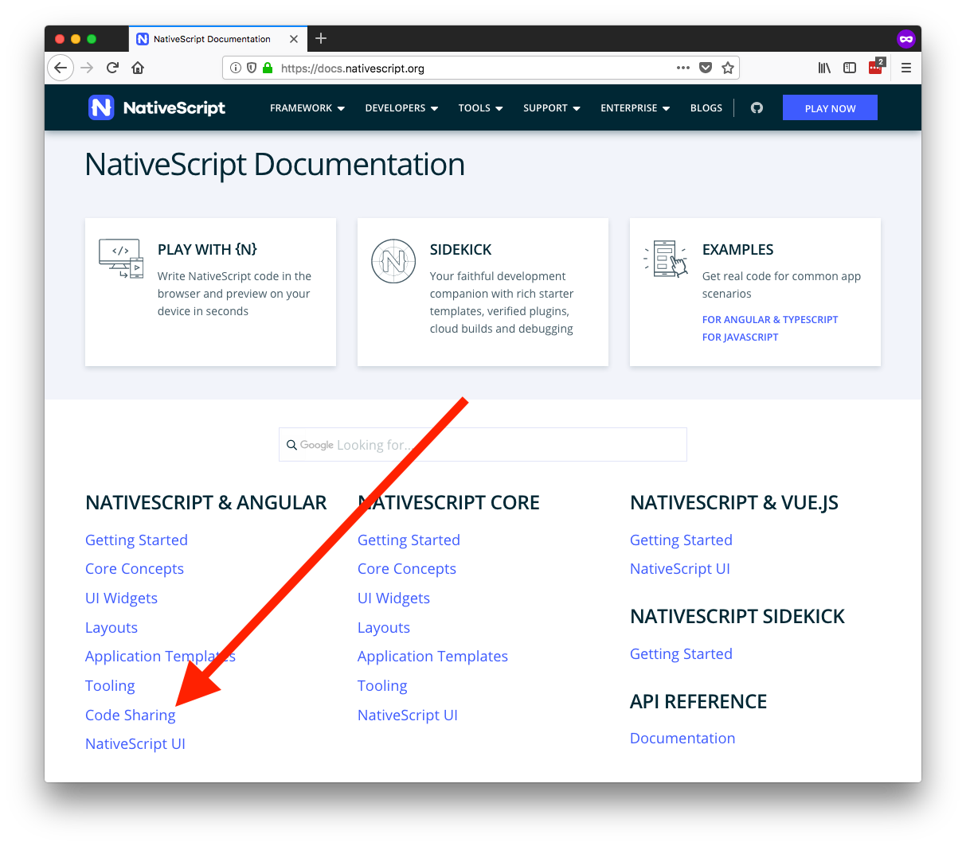

Slide 29
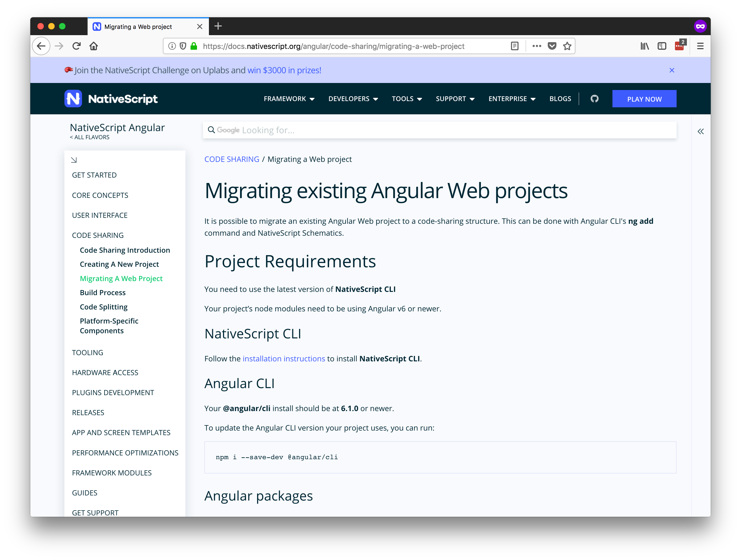

Slide 31
What do you think?

Slide 32
Thanks!
@tjvantoll
Notes:
Feel free to swap out the Progress logo with your own logo.

